Slide 1





IMPRESS: Improving occupational exposure assessment methodologies (EAMs) for epidemiological studies on pesticides
KS Galea, on behalf of the IMPRESS project team

Slide 2
Conflict of interest slide
Funding source: Crop Life Europe (CLE)
The authors declare no financial conflicts of interest.
IMPRESS project team employees of the following organisations:
Project Governance:
Independent Advisory Board provides independent and impartial expert advice
All completed Conflict of Interest forms
Project governance document stating agreed roles, responsibilities and interactions of those involved
Freedom to publish our project findings

Slide 3
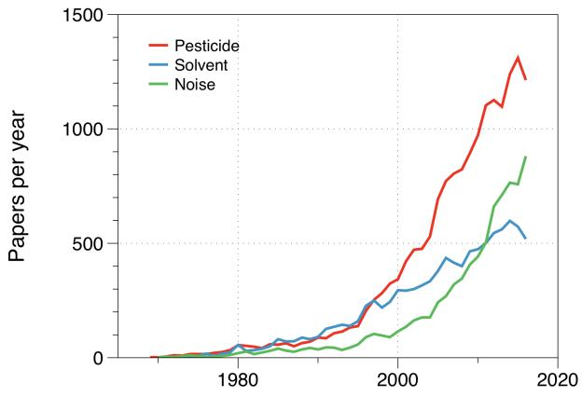
Background
Increasing interest in epidemiological studies of pesticide exposed workers
For chronic diseases retrospective exposure assessment is challenging
Historic measurement data not really available
Numerous EAMs, generally not validated
IMPRESS project aims to:
Better understand performance of EAMs used in epi. studies
Assess reliability and external validity of surrogate measures used to assign exposure within individuals / groups and evaluate size / effects of recall bias on misclassification
Provide recommendations for future studies
Search in Scopus for…
pesticide AND epidemiology AND ( work OR occupational )

Slide 4
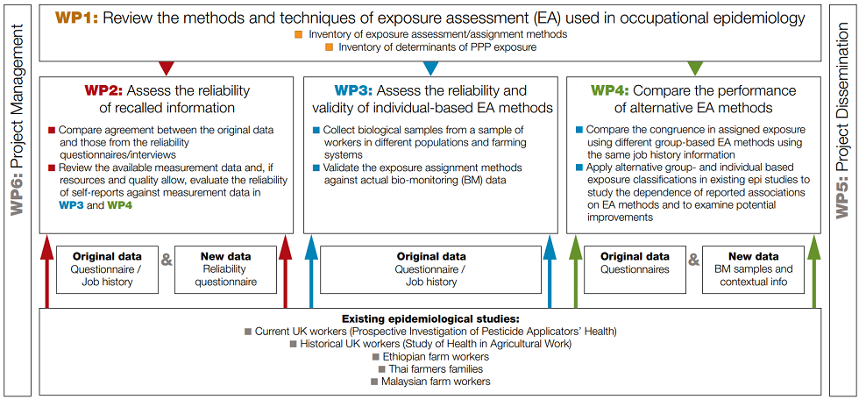
How did we propose to do this?
PIPAH (UK
PUHS (UK)
SHAW (UK)
PESTROP (Uganda)
Malaysian farmers (Malaysia)
Notes:
Use previously collected exposure data from existing epi studies and historical records
Assess current exposure (using biomonitoring) in various populations to examine performance of EA approaches
Compare and contrast performance of EAMs within existing epi studies

Slide 5
Aim of todays presentation
Provide high level overview of key IMPRESS project results to date.

Slide 6
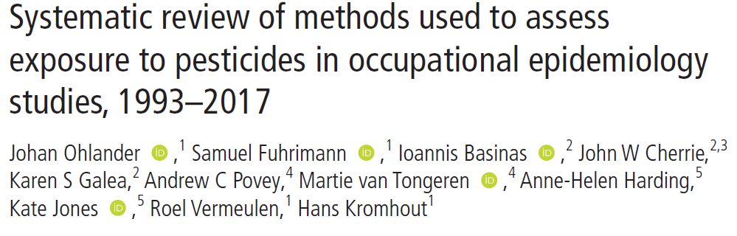
What EAMs are being used?
Searched for articles reporting observational epidemiological studies in MEDLINE and Embase published 1993 to 2017.
The relative frequency of EAM analysed according to EAM type (direct and indirect methods), health outcome, study design, study location (country) and specificity of assessment.
Temporal trends in EAM were analysed.
1271 articles concerned studies performed in 97 countries reviewed

Slide 7
What did our review tell us?
In 1298 included articles 1521 EAM occurrences were documented.
  Indirect EAM (78.3%), primarily self-reported exposures (39.3%) and job titles assessments (9.5%), mainly applied in case-control studies (95.0%), in high-income countries (85.0%) and in studies of doctor-diagnosed health outcomes (>85%).
  Direct EAM (20.8%), primarily biomonitoring of blood (15.6%) or urine (4.7%), predominantly applied in cross-sectional studies (29.8%), in lower middle-income countries (40.9%) and in studies of neurological (50.0%) outcomes.
Between 1993 - 2017, majority of EAM applied were indirect, particularly based on self-reported exposure.
  Use of self-reported exposures and job exposure matrices increased throughout the study period,
  Use of expert-assessments and job title assessments decreased.
  Use of algorithms and predictive models showed no trend.
  No temporal trends in the use of different direct EAM were observed.
Notes:
In studies of occupational exposure to pesticides the majority of
EAM applied were indirect, particularly based on self-reported
exposure. Over the analysed 25 years the ratio of indirect to
direct EAM (5:1) was relatively constant, although with changes
within the category of indirect EAM, particularly attributable to
increasing use of self-reported
exposures and a declining use of
exposure assignment by job title and expert case-by-
case
assessment.
Modelled quantitative exposure data, exposure algorithms
and their use in combination with more traditional methods are
still very scarce in studies on pesticide-related
health effects.
These methods should be further developed and implemented.
This review combined with future studies assessing the validity
of applied EAM, such as the IMPRESS project, will inform
researchers on the magnitude of exposure misclassification when
applying a certain method, and provide ways to improve the
quality of human observational studies on pesticides exposure
leading to more informative study results.

Slide 8
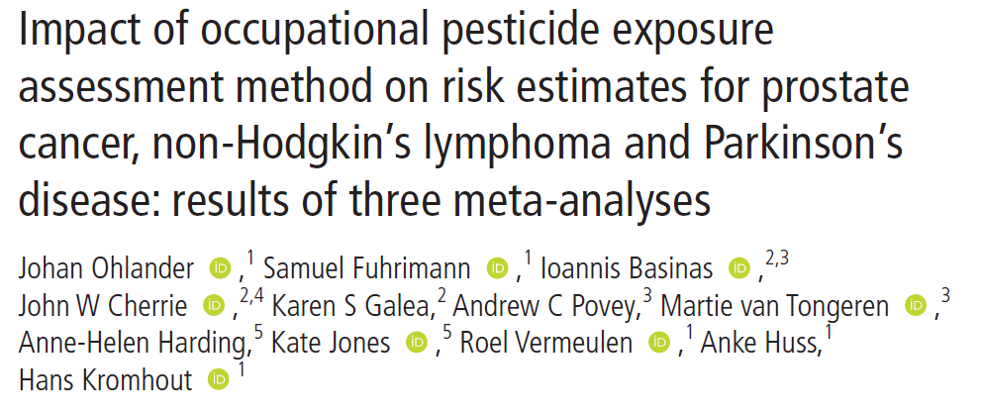
How do the applied EAMs influence risk estimates for some chronic diseases?
We conducted three meta-analyses to specifically investigate how the type of EAM influenced summary risk estimates of prostate cancer (PC), non-Hodgkin’s lymphoma (NHL) and Parkinson’s disease.
Influence of EAM type on the summary risk ratio (sRR) of PC (25 articles), NHL (29 articles) and PD (32 articles) was investigated.
EAM types analysed were: group-level assessments (eg, job titles), self-reported exposures, expert-level assessments (eg, job-exposure matrices) and biomonitoring (eg, blood, urine).
Additionally, sRRs were estimated by study design, publication year period and geographic location where the study was conducted.

Slide 9
What did the meta-analyses tell us?
EAM was not associated with significantly different summary risk estimates for any of the analysed health outcomes.
Study design (for cancer studies), publication year (for studies on NHL) and geographic region where the study was conducted (for PC), showed a larger effect on the summary risk estimates than the applied EAM.
When performing systematic reviews of studies on chronic health effects of occupational pesticide exposure, epidemiological study design, publication year and region where the study was performed, should primarily be considered.

Slide 10
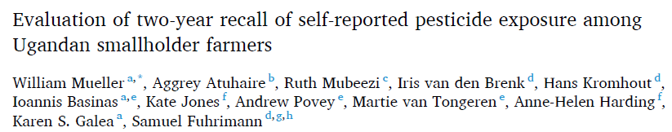
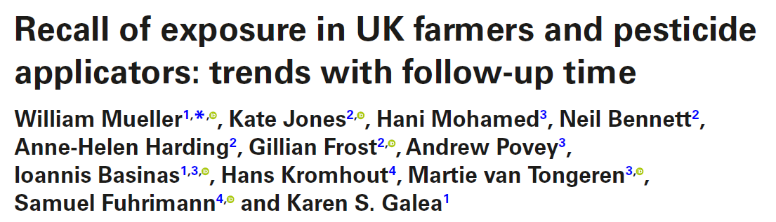
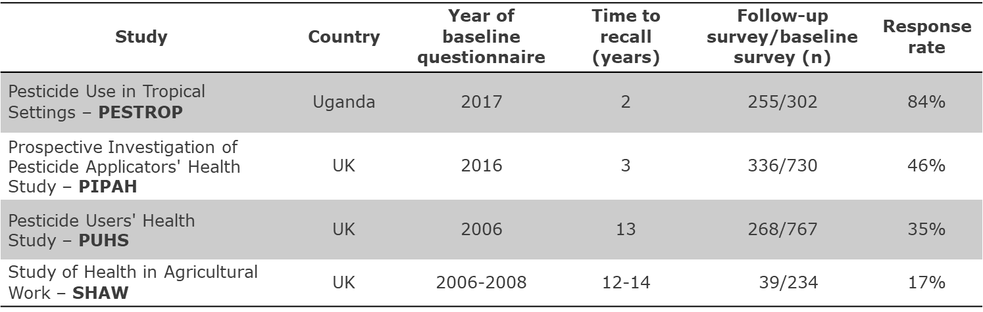
Evaluation of recall of exposure
Found occupational epi. studies on pesticide use commonly rely on self-reported questionnaire or interview data
Insight into recall accuracy important - misclassification of exposures due to imperfect recall can bias risk estimates

Slide 11

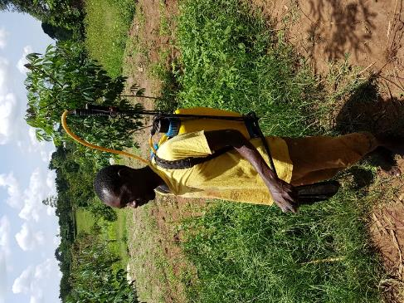
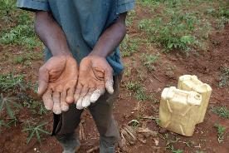
What did we do?
We assessed recall by time, contextual factors,
and demographic characteristics:
  Frequency of pesticide use
  Crops
  PPE worn
  Hygiene practices
  Application methods
  Active ingredients (Uganda only)
Quantitative recall: correlation, regression of geometric mean ratios
Binary recall: sensitivity, specificity, overall agreement, area under curve
Separately examined UK and Uganda cohorts

Slide 12
What did we learn?
UK farmers:
  Results indicate that recall ability may deteriorate over a longer period.
  Although low-response rates may require these findings to be interpreted with caution, recall for a number of exposure determinants appeared reliable, such as crops and hygiene practices within 3 years, as well as days per year working with pesticides.
Uganda farmers:
  Smallholder farmers in Uganda could better recollect after a 2-year period the total number of years using pesticides, as well as certain active ingredients and personal protection equipment (PPE), compared to poorer recall of specific crops.
  More research is needed on recall in poorly educated agriculture communities in low- and middle-income settings to confirm these results.

Slide 13
What are we currently working on?
Evaluation of associations between exposure-modifying factors and urine metabolite measurements with contextual data across cohorts (PESTROP, PIPAH / PUHS, Malaysia)
Comparison of the performance of alternative EAMS in published^{1,2} epidemiological studies of health effects from exposure to pesticides
  Compare pesticide EAMs in the PESTROP Uganda study conducted in 2017 and 2019. Several different exposure metrics will be generated for four (groups of) active ingredients, these being glyphosate, mancozeb, chlorpyrifos and the chemical group pyrethroids
  Compare exposure-response associations for several proxies/metrics of pesticide exposure, with neurobehavioral outcome variables as assessed in 2017 and for several proxies/metrics of pesticide exposure with sleep problem indices as assessed in 2019.
Publications to follow!
  ¹ Exposure to multiple pesticides and neurobehavioral outcomes among smallholder farmers in Uganda. Fuhrimann S, et al.
  Environ Int. 2021 Jul;152:106477. doi: 10.1016/j.envint.2021.106477. Epub 2021 Mar 20.
  ² Recent pesticide exposure affects sleep: A cross-sectional study among smallholder farmers in Uganda. Fuhrimann S, et al.
  Environ Int. 2022 Jan;158:106878. doi: 10.1016/j.envint.2021.106878. Epub 2021 Sep 27.

Slide 14
IMPRESS peer-reviewed publications to date
Jones K, et al (2020) Improving Exposure Assessment Methodologies for Epidemiological Studies on Pesticides: Study Protocol JMIR Res Protoc 2020;9(2):e16448. DOI: 10.2196/16448.
Mueller W, et al (2022) Recall of exposure in UK farmers and pesticide applicators: trends with follow-up time, Annals of Work Exposures and Health, 2022;, wxac002, https://doi.org/10.1093/annweh/wxac002.
Mueller W, et al (2022) Evaluation of two-year recall of self-reported pesticide exposure among Ugandan smallholder farmers. International Journal of Hygiene and Environmental Health; 240. https://doi.org/10.1016/j.ijheh.2021.113911.
Ohlander J, et al. (2022) Impact of occupational pesticide exposure assessment method on risk estimates for prostate cancer, non-Hodgkin’s lymphoma and Parkinson’s disease: results of three meta-analyses. OEM. Published Online First: 07 April 2022. doi: 10.1136/oemed-2021-108046.
Ohlander J, et al (2020) Systematic review of methods used to assess exposure to pesticides in occupational epidemiology studies, 1993–2017. Occupational and Environmental Medicine Published Online First: 25 February 2020. doi: 10.1136/oemed-2019-105880

Slide 15
Thank you for listening!

