Slide 1
Recall bias in epidemiological studies of pesticide use in the IMPRESS study
Will Mueller, Samuel Fuhrimann, Hans Kromhout, Ioannis Basinas, Kate Jones, Andrew Povey, Hani Mohamed, Martie van Tongeren, Anne-Helen Harding, Karen S. Galea
14th UK/Ireland Occupational & Environmental Epidemiology Meeting – 4th June 2021

Slide 2
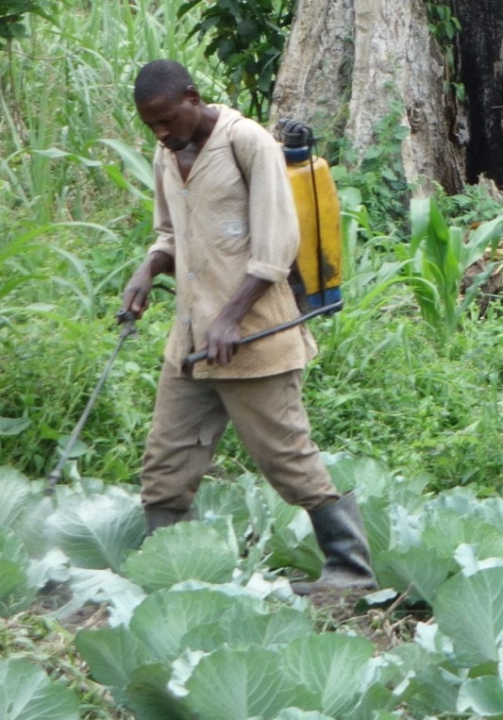
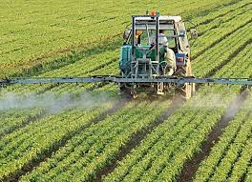
Background
4M t of active ingredients applied globally each year¹
Occupational exposure to pesticides linked to poorer health (e.g., cancers², neurological effects³)
5x more studies use indirect (e.g. self-reported) vs direct (e.g. biomarkers) exposure assessment methods⁴ ->few studies assess recall ability
Improving Exposure Assessment Methodologies for Epidemiological Studies on Pesticides (IMPRESS) project (www.impress-project.org)
Pesticide Use in Tropical Settings (PESTROP) - Uganda
Pesticide Users' Health Study (PUHS) - UK
Prospective Investigation of Pesticide Applicators' Health Study (PIPAH) – UK
Study of Health in Agricultural Work (SHAW) - UK
¹FAOSTAT 2020; ²Alavanja & Bonner 2012; ³Fuhrimann et al 2021; ⁴Ohlander et al 2020

Slide 3
Methods
Participants reported practices at baseline and recalled information 2-15 years later
We assessed recall by time, contextual factors, and demographic characteristics:
Frequency of pesticide use (years/days/hours using pesticides)
Crops (specific and most common)
PPE worn (particular items while mixing and handling)
Hygiene practices (washing hands, changing clothes, bathing)
Application methods (hand-held or tractor based)
Active ingredients (PESTROP only)
Study (country) | Year of original questionnaire | Time to recall (years) | Participants in follow-up survey/baseline survey (n) | Response rate
PESTROP (Uganda) | 2017 | 2 | 255/302 | 84%
PIPAH (UK) | 2016 | 3 | 336/730 | 46%
PUHS (UK) | 2006 | 13 | 268/767 | 35%
SHAW (UK) | 2006-2008 | 13-15 | 39/234 | 17%

Slide 4
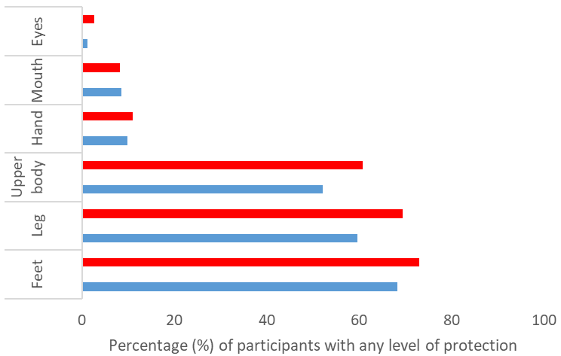
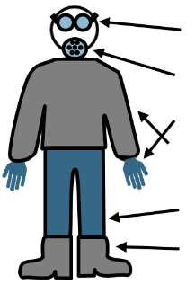
Key Findings
Frequency of pesticide use
High correlation in years: >0.6, but overestimation by 25% in 1 study (PUHS)
No consistent differences by demographic characteristics
Crops
Only 13% remembered top 3 crops (PESTROP), UK >75% agreement for most crops
Active ingredients
Recalled use was higher in 11/14 active ingredients (PESTROP)
PPE
Overall agreement: 70-80%, with low use in Uganda…
Hygiene practices
Overall agreement: 60-70%
Some evidence of bias
Funded by

