Slide 1
A regulatory perspective on the need for improved exposure assessment for epidemiological studies on pesticides
Paul Y Hamey
Chemicals Regulation Division

Slide 2
Pesticides are regulated!
EU Regulation 1107/2009
- presumption harmful to health & environment
Extensive data package to support proposed introduction
Use only allowed where evidence predicts no risk of harm to health, or unacceptable risk to wildlife/environment

Slide 3
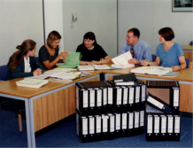
Health risk assessment
Genotoxicity
Toxicokinetics (ADME)
Acute (3 routes) + irritancy/sensitisation
Repeat dose (>2 species) [+dermal &/or inhalation]
Chronic / carcinogenicity (2 species)
Developmental (2 species) & Reproduction (2 generation)
Special studies (mechanisms, neurotoxicity, metabolites, impurities, endocrine effects)

Slide 4

Hazard identification & health based exposure limits
SPECIES
DIFFERENCES
HUMAN
VARIABILITY
10
10

Slide 5
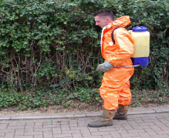
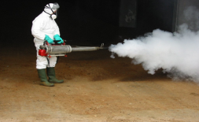
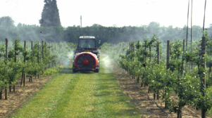
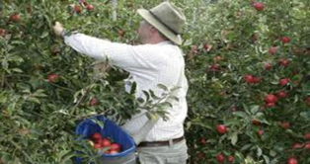
Exposure during and after use

Slide 6





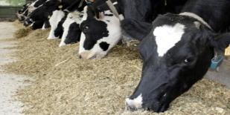
Residues in food and feed

Slide 7
Uncertainties
Extrapolation from animal models
No models for some human diseases
Complexity of real exposures
Epidemiology important alternative source of information
  Where available must be submitted

Slide 8
Developing regulatory approach
EFSA Guidance on submission of peer-reviewed literature (EFSA 2011)
EFSA External report: review of pesticide epidemiology studies 2006-2012 (Ntzani et al, 2013)
  Large number of articles & analysis
  Some associations that merit further investigation
  No firm conclusions for majority of outcomes

Slide 9
EFSA External report
Stated limitations
  Lack of direct exposure assessment
    Lack of appropriate biomarkers
    Use of questionnaires (not validated)
    Recall bias in retrospective studies
    No specific exposure information
  Use of generic pesticide definitions
(~10% studies DDT & metabolites)

Slide 10
Best observed approach
Agricultural Health Study
  Prospective approach, specific a.s.
    (cost, power, time…?)
  Biological monitoring to calibrate exposure models (incl. PPE modifiers)
  (Thomas et al, 2010, Coble et al, 2011, Hines et al, 2011)
    (cost, specificity, short ½-lives, temporal variation…?)

Slide 11
Seasonal use (French example)

Slide 12
Seasonal use – remainder of year

Slide 13
Requirements
Regulatory approach requires specific pesticide descriptions
Method of use – may modify exposure
User and other worker behaviours including use of PPE - may modify exposure

Slide 14
Possible approaches
Personal exposure monitors
Personal biomonitoring
Population level use of farmers’ mandatory pesticide use records
  Cropping patterns and use surveys
  (e.g. The Environment & Health Atlas for England & Wales, Hansell et al, 2003)
Future - exposome and metabolomics?

Slide 15
Thank you

